Slide 1

Chapter 5. Joint Probability Distributions and Random Sample
Weiqi Luo (骆伟祺)
School of Data & Computer Science
Sun Yat-Sen University
Email：luoweiqi@mail.sysu.edu.cn

Slide 2
Chapter 5: Joint Probability Distributions and Random Sample
5.1. Jointly Distributed Random Variables
5.2. Expected Values, Covariance, and Correlation
5. 3. Statistics and Their Distributions
5.4. The Distribution of the Sample Mean
5.5. The Distribution of a Linear Combination

Slide 3
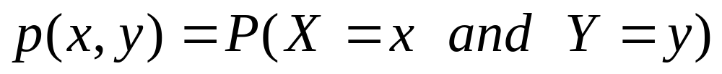
5.1. Jointly Distributed Random Variables
The Joint Probability Mass Function for Two Discrete Random Variables
Let X and Y be two discrete random variables defined on the sample space S of an experiment. The joint probability mass function p(x,y) is defined for each pair of numbers (x,y) by

Slide 4
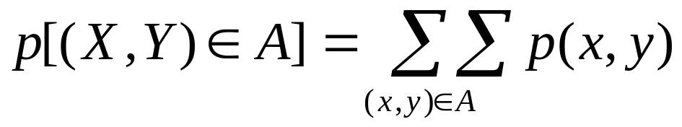
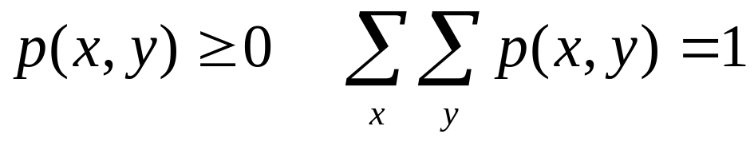
5.1. Jointly Distributed Random Variables
Let A be any set consisting of pairs of (x,y) values. Then the probability P[(X,Y)∈A] is obtained by summing the joint pmf over pairs in A:
Two requirements for a pmf

Slide 5
5.1. Jointly Distributed Random Variables
Example 5.1
A large insurance agency services a number of customers who have purchased both a homeowner’s policy and an automobile policy from the agency. For each type of policy, a deductible amount must be specified. For an automobile policy, the choices are $100 and $250, whereas for a homeowner’s policy the choices are 0, $100, and $200.
Suppose an individual with both types of policy is selected at random from the agency’s files. Let X = the deductible amount on the auto policy, Y = the deductible amount on the homeowner’s policy
Joint Probability Table
y
p(x,y)
0 100 200
100
250
0.20 0.10 0.20
0.05 0.15 0.30
x

Slide 6
5.1. Jointly Distributed Random Variables
Example 5.1 (Cont’)
y
p(x,y)
0 100 200
100
250
0.20 0.10 0.20
0.05 0.15 0.30
x
p(100,100) =P(X=100 and Y=100) = 0.10
P(Y ≥ 100) = p(100,100) + p(250,100) + p(100,200) + p(250,200) = 0.75

Slide 7
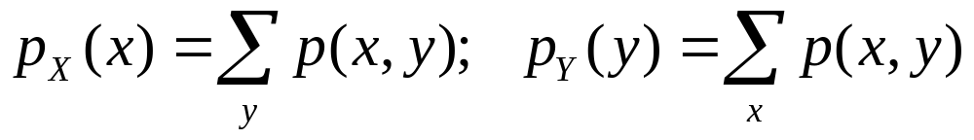
5.1. Jointly Distributed Random Variables
The marginal probability mass function
The marginal probability mass functions of X and Y, denoted by p_{X}(x) and p_{Y}(y), respectively, are given by
p_{Y}
 | Y₁ | Y₂ | … | Y_{m-1} | Y_{m}
X₁ | p_{1,1} | p_{1,2} |  | p_{1,m-1} | p_{1,m}
X₂ | p_{2,1} | p_{2,2} |  | p_{2,m-1} | p_{2,m}
…
X_{n-1} | p_{n-1,m} | p_{n-1,m} |  | p_{n-1,m} | p_{n-1,m}
X_{n} | p_{n,m} | p_{n,m} |  | p_{n,m} | p_{n,m}
p_{X}

Slide 8
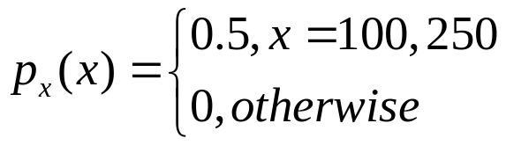
5.1. Jointly Distributed Random Variables
Example 5.2 (Ex. 51. Cont’)
The possible X values are x=100 and x=250, so computing row totals in the joint probability table yields
y
p(x,y)
0 100 200
100
250
0.20 0.10 0.20
0.05 0.15 0.30
x
p_{x}(100)=p(100,0 )+p(100,100)+p(100,200)=0.5
p_{x}(250)=p(250,0 )+p(250,100)+p(250,200)=0.5

Slide 9
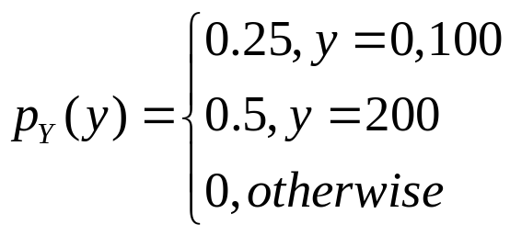
5.1. Jointly Distributed Random Variables
Example 5.2 (Cont’)
y
p(x,y)
0 100 200
100
250
0.20 0.10 0.20
0.05 0.15 0.30
x
p_{y}(0)=p(100,0)+p(250,0)=0.2+0.05=0.25
p_{y}(100)=p(100,100)+p(250,100)=0.1+0.15=0.25
p_{y}(200)=p(100,200)+p(250,200)=0.2+0.3=0. 5
P(Y ≥ 100) = p(100,100) + p(250,100) + p(100,200) + p(250,200)
= p_{Y}(100)+p_{Y} (200) =0.75

Slide 10
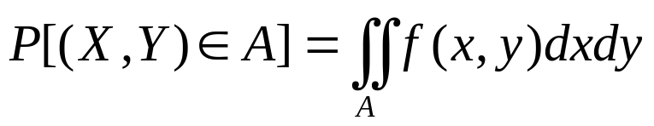
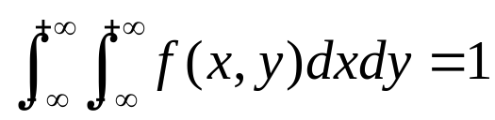
5.1. Jointly Distributed Random Variables
The Joint Probability Density Function for Two Continuous Random Variables
Let X and Y be two continuous random variables. Then f(x,y) is the joint probability density function for X and Y if for any two-dimensional set A
Two requirements for a joint pdf
1. f(x,y) ≥ 0; for all pairs (x,y) in R²
2.

Slide 11
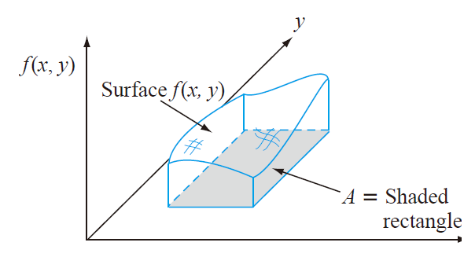
5.1. Jointly Distributed Random Variables
In particular, if A is the two-dimensional rectangle {(x,y):a ≤ x ≤ b, c ≤ y ≤ d},then

Slide 12
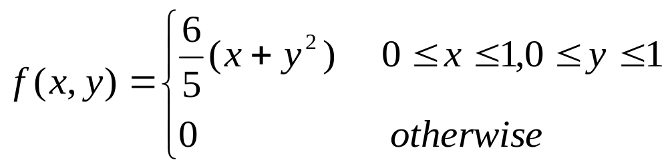
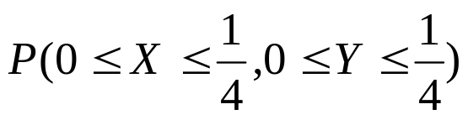
5.1. Jointly Distributed Random Variables
Example 5.3
A bank operates both a drive-up facility and a walk-up window. On a randomly selected day, let X = the proportion of time that the drive-up facility is in use, Y = the proportion of time that the walk-up window is in use. Let the joint pdf of (X,Y) be
Verify that f(x,y) is a joint probability density function;
Determine the probability

Slide 13
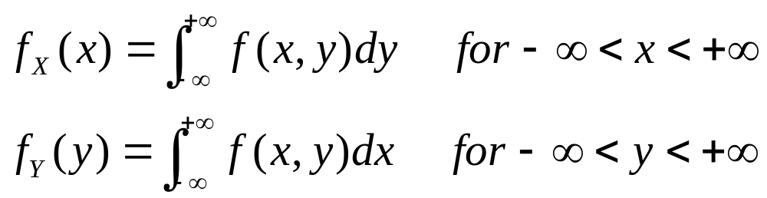
5.1. Jointly Distributed Random Variables
Marginal Probability density function
The marginal probability density functions of X and Y, denoted by f_{X}(x) and f_{Y}(y), respectively, are given by
Y
Fixed y
X
Fixed x

Slide 14
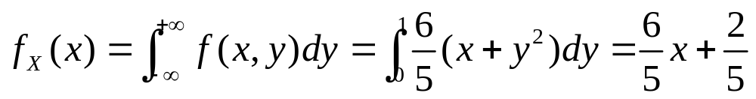
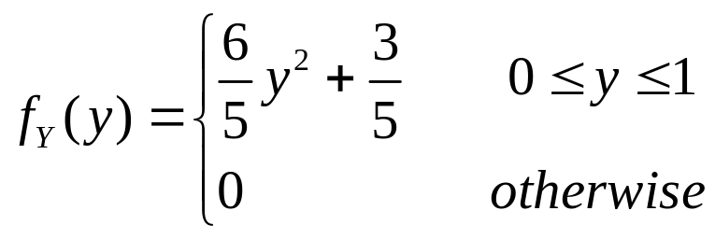
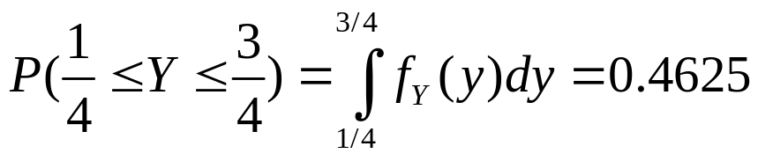
5.1. Jointly Distributed Random Variables
Example 5.4 (Ex. 5.3 Cont’)
The marginal pdf of X, which gives the probability distribution of busy time for the drive-up facility without reference to the walk-up window, is
for x in (0,1); and 0 for otherwise.
Then

Slide 15
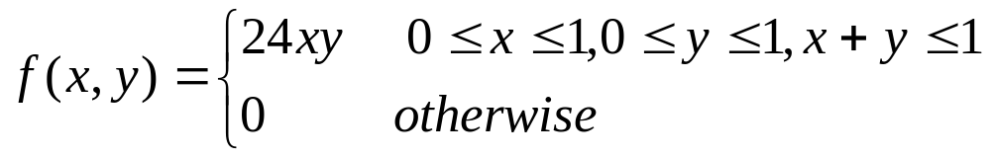
5.1. Jointly Distributed Random Variables
Example 5.5
A nut company markets cans of deluxe mixed nuts containing almonds, cashews, and peanuts. Suppose the net weight of each can is exactly 1 lb, but the weight contribution of each type of nut is random. Because the three weights sum to 1, a joint probability model for any two gives all necessary information about the weight of the third type. Let X = the weight of almonds in a selected can and Y = the weight of cashews. The joint pdf for (X,Y) is

Slide 16
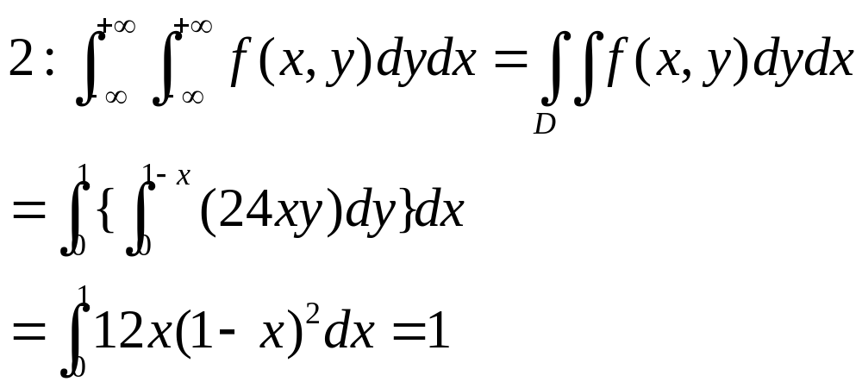
5.1. Jointly Distributed Random Variables
Example 5.5 (Cont’)
(0,1)
1: f(x,y) ≥ 0
(x,1-x)
x
(1, 0)

Slide 17
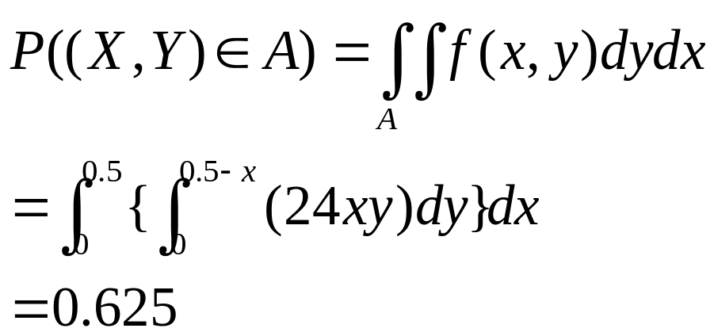
5.1. Jointly Distributed Random Variables
Example 5.5 (Cont’)
Let the two type of nuts together make up at most 50%
of the can, then A={(x,y); 0≤x ≤1; 0 ≤ y ≤ 1, x+y ≤ 0.5}
(0,1)
x+y=0.5
(1, 0)

Slide 18
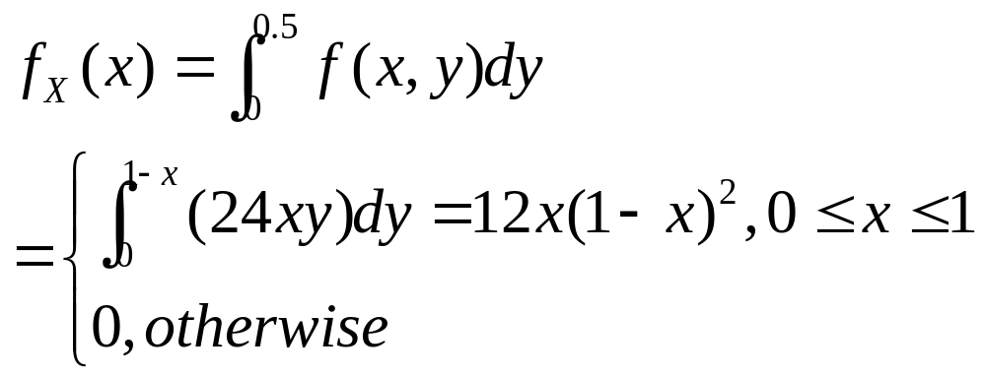
5.1. Jointly Distributed Random Variables
Example 5.5 (Cont’)
The marginal pdf for almonds is obtained by holding X fixed at x and integrating f(x,y) along the vertical line through x:
(0,1)
(x,1-x)
x
(1, 0)

Slide 19


5.1. Jointly Distributed Random Variables
Independent Random Variables
Two random variables X and Y are said to be independent if for every pair of x and y values,
Otherwise, X and Y are said to be dependent.
when X and Y are discrete
when X and Y are continuous
Namely, two variables are independent if their joint pmf or pdf is the product of
the two marginal pmf’s or pdf’s.

Slide 20
5.1. Jointly Distributed Random Variables
Example 5.6
In the insurance situation of Example 5.1 and 5.2
So, X and Y are not independent.
y
p(x,y)
0 100 200
100
250
0.20 0.10 0.20
0.05 0.15 0.30
x

Slide 21
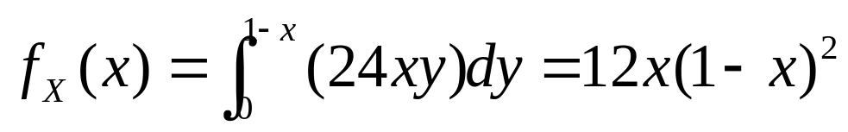
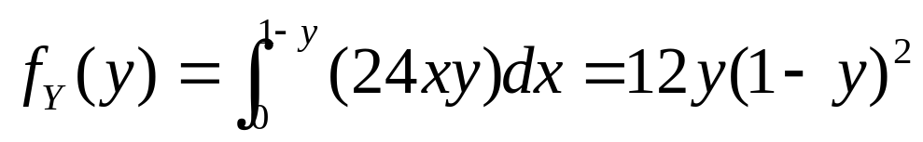
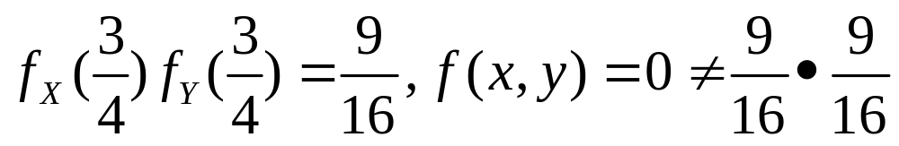
5.1. Jointly Distributed Random Variables
Example 5.7 (Ex. 5.5 Cont’)
Because f(x,y) has the form of a product, X and Y would appear to be independent. However, although
By symmetry

Slide 22
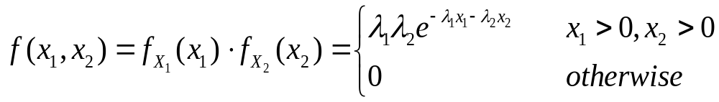
5.1. Jointly Distributed Random Variables
Example 5.8
Suppose that the lifetimes of two components are independent of one another and that the first lifetime, X₁, has an exponential distribution with parameter λ₁ whereas the second, X₂, has an exponential distribution with parameter λ₂. Then the joint pdf is
Let λ₁ =1/1000 and λ₂=1/1200. So that the expected lifetimes are 1000 and 1200 hours, respectively. The probability that both component lifetimes are at least 1500 hours is

Slide 23
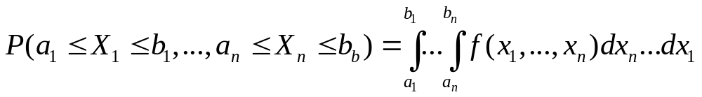
5.1. Jointly Distributed Random Variables
More than Two Random Variables
If X₁, X₂, …, X_{n} are all discrete rv’s, the joint pmf of the variables is the function
If the variables are continuous, the joint pdf of X₁, X₂, …, X_{n} is the function f(x₁, x₂, …, x_{n}) such that for any n intervals [a₁, b₁], …, [a_{n}, b_{n}],
p(x₁, x₂, …, x_{n}) = P(X₁ = x₁, X₂ = x₂, …, X_{n} = x_{n})

Slide 24
5.1. Jointly Distributed Random Variables
Independent
The random variables X₁, X₂, …X_{n} are said to be independent if for every subset X_{i1}, X_{i2},…, X_{ik} of the variable, the joint pmd or pdf of the subset is equal to the product of the marginal pmf’s or pdf’s.

Slide 25
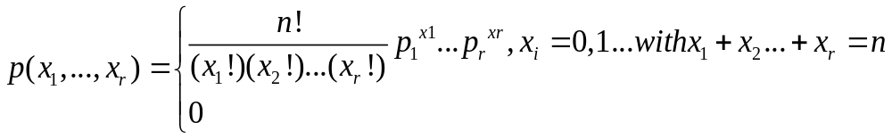
5.1. Jointly Distributed Random Variables
Multinomial Experiment
An experiment consisting of n independent and identical trials, in which each trial can result in any one of r possible outcomes. Let p_{i}=P(Outcome i on any particular trial), and define random variables by X_{i}=the number of trials resulting in outcome i (i=1,…,r). The joint pmf of X₁,…,X_{r} is called the multinomial distribution.
Note: the case r=2 gives the binomial distribution.

Slide 26
5.1. Jointly Distributed Random Variables
Example 5.9
If the allele of each of then independently obtained pea sections id determined and p₁=P(AA), p₂=P(Aa), p₃=P(aa), X₁= number of AA’s, X₂=number of Aa’s and X₃=number of aa’s, then
If p₁=p₃=0.25, p₂=0.5, then

Slide 27
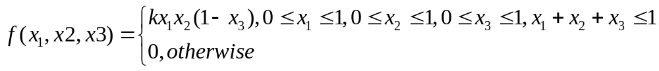
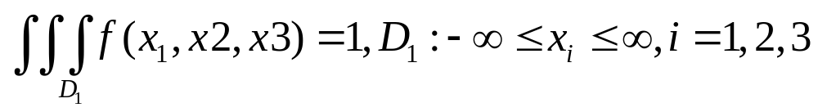
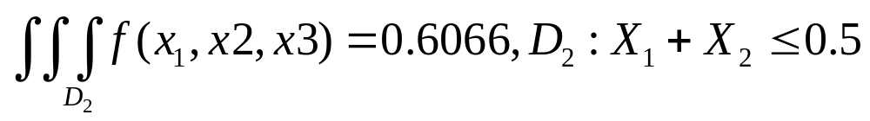
5.1. Jointly Distributed Random Variables
Example 5.10
When a certain method is used to collect a fixed volume of rock samples in a region, there are four resulting rock types. Let X₁, X₂, and X₃ denote the proportion by volume of rock types 1, 2 and 3 in a randomly selected sample. If the joint pdf of X₁,X₂ and X₃ is
k=144.

Slide 28
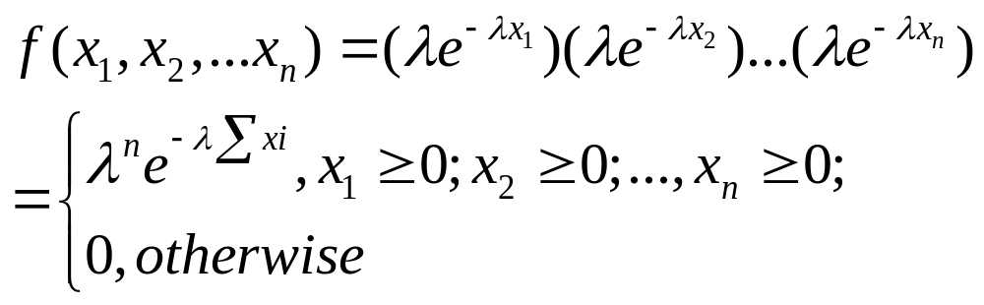
5.1. Jointly Distributed Random Variables
Example 5.11
If X₁, …,X_{n} represent the lifetime of n components, the components operate independently of one another, and each lifetime is exponentially distributed with parameter, then

Slide 29
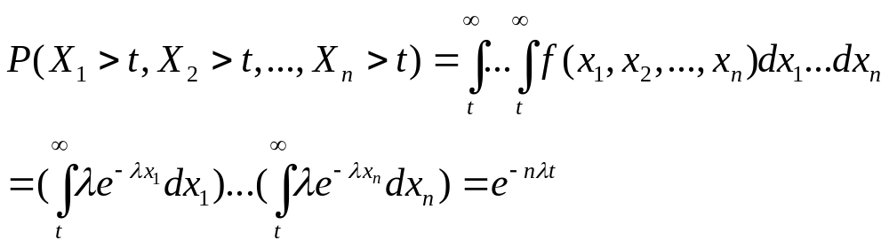
5.1. Jointly Distributed Random Variables
Example 5.11 (Cont’)
If there n components constitute a system that will fail as soon as a single component fails, then the probability that the system lasts past time is
therefore,

Slide 30
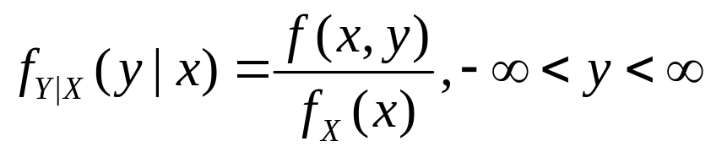
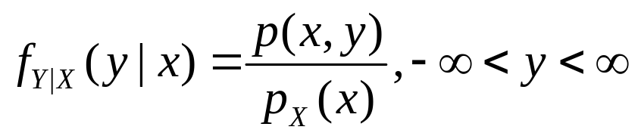
5.1. Jointly Distributed Random Variables
Conditional Distribution
Let X and Y be two continuous rv’s with joint pdf f(x,y) and marginal X pdf f_{X}(x). Then for any X values x for which f_{X}(x)>0, the conditional probability density function of Y given that X=x is
If X and Y are discrete, then
is the conditional probability mass function of Y when X=x.

Slide 31
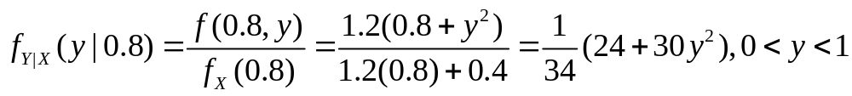
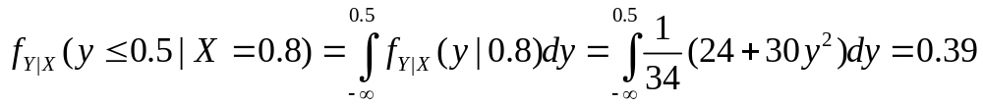
5.1. Jointly Distributed Random Variables
Example 5.12 (Ex.5.3 Cont’)
X= the proportion of time that a bank’s drive-up facility is busy and Y=the analogous proportion for the walk-up window. The conditional pdf of Y given that X=0.8 is
The probability that the walk-up facility is busy at most half the time given that X=0.8 is then

Slide 32
5.1. Jointly Distributed Random Variables
Homework
Ex. 8, Ex.12, Ex.18, Ex.20

Slide 33
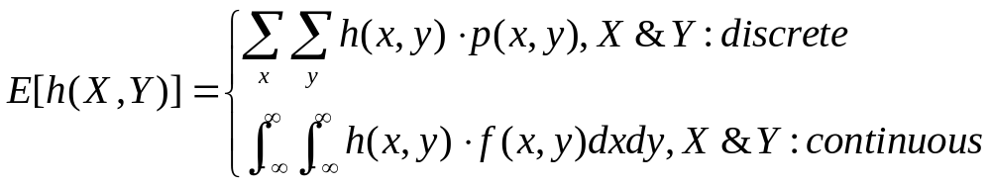
5.2 Expected Values, Covariance, and Correlation
The Expected Value of a function h(x,y)
Let X and Y be jointly distribution rv’s with pmf p(x,y) or pdf f(x,y) according to whether the variables are discrete or continuous. Then the expected value of a function h(X,Y), denoted by E[h(X,Y)] or μ_{h(X,Y)} , is given by

Slide 34
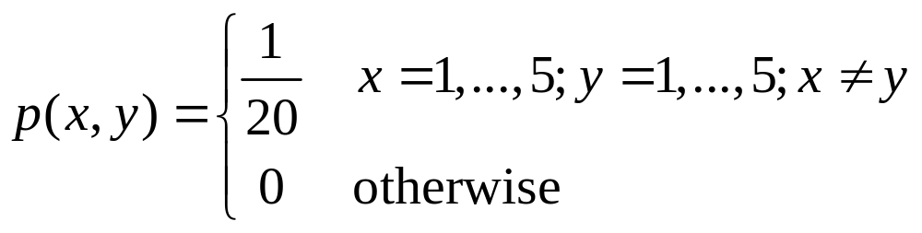
5.2 Expected Values, Covariance, and Correlation
Example 5.13
Five friends have purchased tickets to a certain concert. If the tickets are for seats 1-5 in a particular row and the tickets are randomly distributed among the five, what is the expected number of seats separating any particular two of the five?
The number of seats separating the two individuals is
h(X,Y)=|X-Y|-1

Slide 35
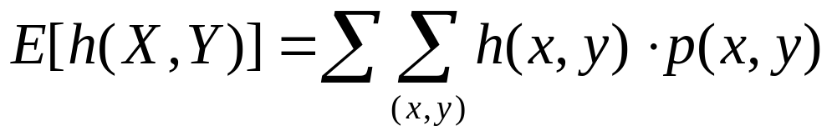
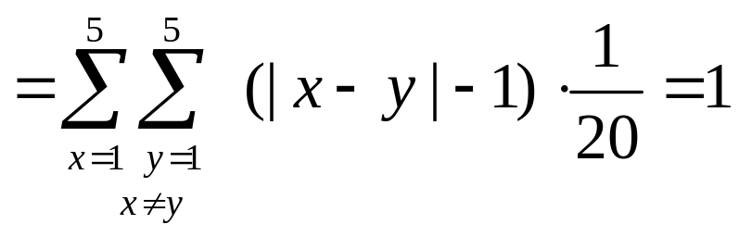
5.2 Expected Values, Covariance, and Correlation
Example 5.13 (Cont’)
x
h(x,y)
1
2
3
4
5
1
--
0
1
2
3
2
0
--
0
1
2
y
3
1
0
--
0
1
4
2
1
0
--
0
5
3
2
1
0
--

Slide 36
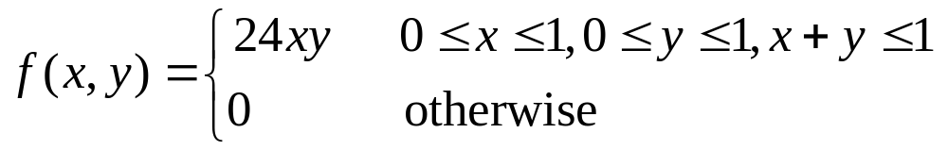
5.2 Expected Values, Covariance, and Correlation
Example 5.14
In Example 5.5, the joint pdf of the amount X of almonds and amount Y of cashews in a 1-lb can of nuts was
If 1 lb of almonds costs the company $1.00, 1 lb of cashews costs $1.50, and 1 lb of peanuts costs $0.50, then the total cost of the contents of a can is
h(X,Y)=(1)X+(1.5)Y+(0.5)(1-X-Y)=0.5+0.5X+Y

Slide 37
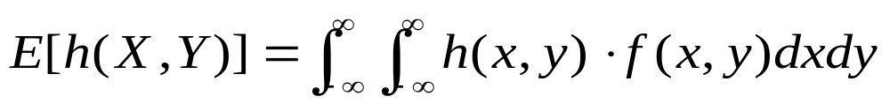
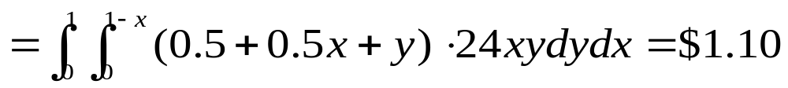
5.2 Expected Values, Covariance, and Correlation
Example 5.14 (Cont’)
The expected total cost is
Note: The method of computing E[h(X₁,…, X_{n})], the expected value of a function h(X₁, …, X_{n}) of n random variables is similar to that for two random variables.

Slide 38
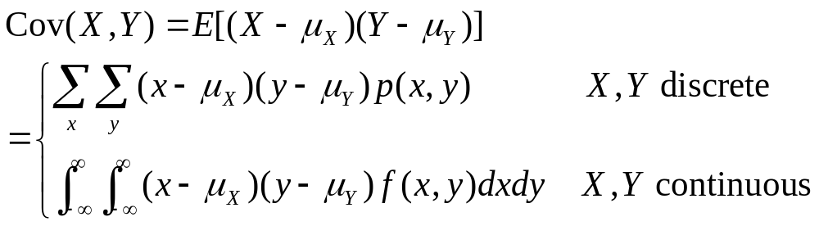
5.2 Expected Values, Covariance, and Correlation
Covariance
The Covariance between two rv’s X and Y is

Slide 39
5.2 Expected Values, Covariance, and Correlation
Illustrates the different possibilities.
-
+
-
+
y
-
+
y
y
μ_{Y}
μ_{Y}
μ_{Y}
+
-
+
-
+
-
x
x
x
μ_{X}
μ_{X}
μ_{X}
(a) positive covariance
(b) negative covariance;
(c) covariance near zero
Here: P(x, y) =1/10

Slide 40
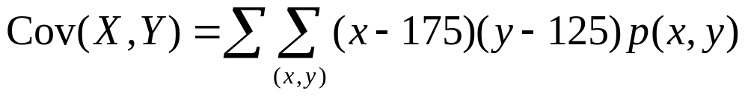

5.2 Expected Values, Covariance, and Correlation
Example 5.15
The joint and marginal pmf’s for X = automobile policy deductible amount and Y = homeowner policy deductible amount in Example 5.1 were
y
p(x,y)
0
100
200
x
100
250
y
0
100
250
100
.20
.10
.20
p_{X}(x)
.5
.5
x
p_{Y}(y)
.25
.25
.5
250
.05
.15
.30
From which μ_{X}=∑xp_{X}(x)=175 and μ_{Y}=125. Therefore

Slide 41
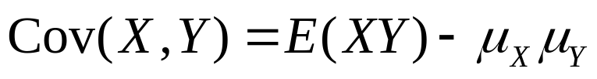
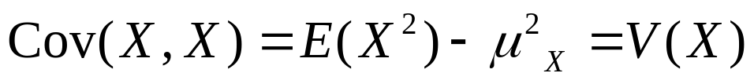
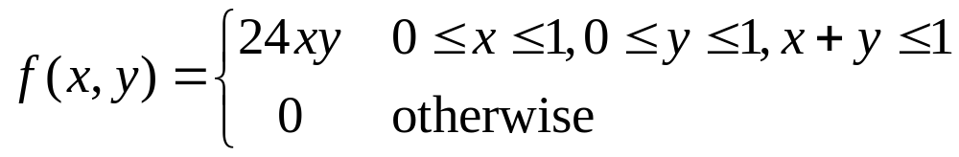
5.2 Expected Values, Covariance, and Correlation
Proposition
Note:
Example 5.16 (Ex. 5.5 Cont’)
The joint and marginal pdf’s of X = amount of almonds and Y = amount of cashews were

Slide 42
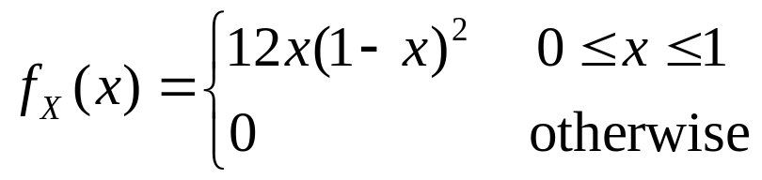
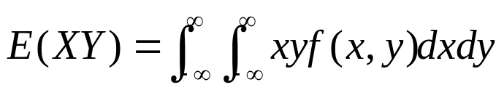
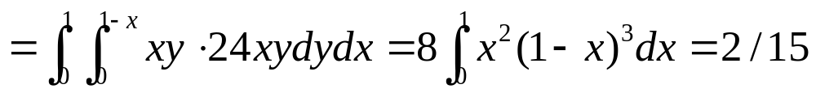
5.2 Expected Values, Covariance, and Correlation
Example 5.16 (Cont’)
f_{Y}(y) can be obtained through replacing x by y in f_{X}(x). It is easily verified that μ_{X} = μ_{Y} = 2/5, and
Thus Cov(X,Y) = 2/15 - (2/5)² = 2/15 - 4/25 = -2/75. A negative covariance is reasonable here because more almonds in the can implies fewer cashews.

Slide 43
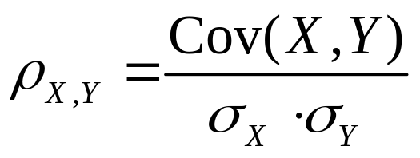
5.2 Expected Values, Covariance, and Correlation
Correlation
The correlation coefficient of X and Y, denoted by Corr(X,Y), ρ_{X,Y} or just ρ, is defined by
Example 5.17
It is easily verified that in the insurance problem of Example 5.15, σ_{X} = 75 and σ_{Y} = 82.92. This gives
The normalized version of Cov(X,Y)
ρ = 1875/(75)(82.92)=0.301

Slide 44
5.2 Expected Values, Covariance, and Correlation
Proposition
1. If a and c are either both positive or both negative
Corr(aX+b, cY+d) = Corr(X,Y)
2. For any two rv’s X and Y, -1 ≤ Corr(X,Y) ≤ 1.
3. If X and Y are independent, then ρ = 0, but ρ = 0 does not imply independence.
4. ρ = 1 or –1 iff Y = aX+b for some numbers a and b with a ≠ 0.

Slide 45

5.2 Expected Values, Covariance, and Correlation
Example 5.18
Let X and Y be discrete rv’s with joint pmf
It is evident from the figure that the value of X is completely determined by the value of Y and vice versa, so the two variables are completely dependent.
However, by symmetry μ_{X} = μ_{Y} = 0 and E(XY) = (-4)1/4 + (-4)1/4 + (4)1/4 + (4)1/4 = 0, so Cov(X,Y) = E(XY) - μ_{X} μ_{Y} = 0 and thus ρ_{XY} = 0.
Although there is perfect dependence, there is also complete absence of any linear relationship!

Slide 46


5.2 Expected Values, Covariance, and Correlation
Another Example
X and Y are uniform distribution in an unit circle
(1,0)
Obviously, X and Y are dependent.
However, we have

Slide 47
5.2 Expected Values, Covariance, and Correlation
Homework
Ex. 23, Ex. 26, Ex. 33, Ex. 35

Slide 48

5.3 Statistics and Their Distributions
Example 5.19
Given a Weibull Population with α=2, β=5
~
μ= 4.4311, μ= 4.1628, δ=2.316

Slide 49

5.3 Statistics and Their Distributions
Example 5.19 (Cont’)

Slide 50
5.3 Statistics and Their Distributions
Example 5.19 (Cont’)
Sample | 1 | 2 | 3 | 4 | 5 | 6
Mean | 4.401 | 5.928 | 4.229 | 4.132 | 3.620 | 5.761
Median | 4.360 | 6.144 | 4.608 | 3.857 | 3.221 | 6.342
Standard Deviation | 2.642 | 2.062 | 1.611 | 2.124 | 1.678 | 2.496
Function of the
sample observation
Sample 1
A quantity #1
Function of the
sample observation
statistic
Population
Sample 2
A quantity #2
…
Function of the
sample observation
Sample k
A quantity #k

Slide 51
5.3 Statistics and Their Distributions
Statistic
A statistic is any quantity whose value can be calculated from sample data (with a function).
Prior to obtaining data, there is uncertainty as to what value of any particular statistic will result. Therefore, a statistic is a random variable. A statistic will be denoted by an uppercase letter; a lowercase letter is used to represent the calculated or observed value of the statistic.
The probability distribution of a statistic is sometimes referred to as its sampling distribution. It describes how the statistic varies in value across all samples that might be selected.

Slide 52
5.3 Statistics and Their Distributions
The probability distribution of any particular statistic depends on
The population distribution, e.g. the normal, uniform, etc. , and the corresponding parameters
The sample size n
The method of sampling, e.g. sampling with replacement or without replacement

Slide 53
5.3 Statistics and Their Distributions
Example
Consider selecting a sample of size n = 2 from a population consisting of just the three values 1, 5, and 10, and suppose that the statistic of interest is the sample variance.
If sampling is done “with replacement”, then S² = 0 will result if X₁ = X₂.
If sampling is done “without replacement”, then
S² can not equal 0.

Slide 54
5.3 Statistics and Their Distributions
Random Sample
The rv’s X₁, X₂,…, X_{n} are said to form a (simple) random sample of size n if
The Xi’s are independent rv’s.
Every Xi has the same probability distribution.
When conditions 1 and 2 are satisfied, we say that the X_{i}’s are independent and identically distributed (i.i.d)
Note: Random sample is one of commonly used sampling methods in practice.

Slide 55
5.3 Statistics and Their Distributions
Random Sample
Sampling with replacement or from an infinite population is random sampling.
Sampling without replacement from a finite population is generally considered not random sampling. However, if the sample size n is much smaller than the population size N (n/N ≤ 0.05), it is approximately random sampling.
Note: The virtue of random sampling method is that the probability distribution of any statistic can be more easily obtained than for any other sampling method.

Slide 56
5.3 Statistics and Their Distributions
Deriving the Sampling Distribution of a Statistic
Method #1: Calculations based on probability rules
e.g. Example 5.20 & 5.21
Method #2:
Carrying out a simulation experiments
e.g. Example 5.22 & 5.23

Slide 57

5.3 Statistics and Their Distributions
Example 5.20
A certain brand of MP3 player comes in three configurations: a model with 2 GB of memory, costing $80, a 4 GB model priced at $100, and an 8 GB version with a price tag of $120. If 20% of all purchasers choose the 2 GB model, 30% choose the 4 GB model, and 50% choose the 8 GB model, then the probability distribution of the cost X of a single randomly selected MP3 player purchase is given by
Suppose on a particular day only two MP3 players are sold. Let X₁ the revenue from the first sale and X₂ the revenue from the second.
Suppose that X₁ and X₂ are independent,

Slide 58


5.3 Statistics and Their Distributions
Example 5.20 (Cont’)
Known the Population Distribution

Slide 59


5.3 Statistics and Their Distributions
Example 5.20 (Cont’)
N=2
N=4

Slide 60




5.3 Statistics and Their Distributions
Example 5.21
Service time for a certain type of bank transaction is a random variable having an exponential distribution with parameter λ. Suppose X₁ and X₂ are service times for two different customers, assumed independent of each other. Consider the total service time T_{o} = X₁ + X₂ for the two customers, also a statistic. What is the pdf of T_{o}?
The cdf of T_{o} is, for t≥0
x₂
(x₁,t-x₁)
x₁+x₂= t
x₁

Slide 61




5.3 Statistics and Their Distributions
Example 5.21 (Cont’)
The pdf of T_{o} is obtained by differentiating F_{To}(t);
This is a gamma pdf (α = 2 and β = 1/λ).
The pdf of = T_{o}/2 is obtained from the relation { ≤ }iff {T_{o} ≤ 2 } as

Slide 62
5.3 Statistics and Their Distributions
Simulation Experiments
This method is usually used when a derivation via probability rules is too difficult or complicated to be carried out. Such an experiment is virtually always done with the aid of a computer. And the following characteristics of an experiment must be specified:
The statistic of interest (e.g. sample mean, S, etc.)
The population distribution (normal with μ = 100 and σ = 15, uniform with lower limit A = 5 and upper limit B = 10, etc.)
The sample size n (e.g., n = 10 or n = 50)
The number of replications k (e.g., k = 500 or 1000) (the actual sampling distribution emerges as k→∞)

Slide 63

5.3 Statistics and Their Distributions
Example 5.23
Consider a simulation experiment in which the population distribution is quite skewed. Figure shows the density curve of a certain type of electronic control (actually a lognormal distribution with E(ln(X)) = 3 and V(ln(X))=.4).
E(X)=μ=21.7584, V(X)=σ²=82.1449

Slide 64

5.3 Statistics and Their Distributions
Example 5.23 (Cont’)
Center of the sampling distribution remains at the population mean.
As n increases:
  Less skewed
  (“more normal”)
  More concentrated (“smaller variance”)

Slide 65
5.3 Statistics and Their Distributions
Homework
Ex.38, Ex.42, Ex. 43

Slide 66


5.4 The Distribution of the Sample Mean
Proposition
Let X₁, X₂, …, X_{n} be a random sample (i.i.d. rv’s) from a distribution with mean value μ and standard deviation σ. Then
In addition, with T_{o}=X₁+…+X_{n} (the sample total),
Refer to 5.5 for the proof!

Slide 67


5.4 The Distribution of the Sample Mean
Example 5.24
In a notched tensile fatigue test on a titanium specimen, the expected number of cycles to first acoustic emission (used to indicate crack initiation) is μ = 28,000, and the standard deviation of the number of cycles is σ = 5000.
Let X₁, X₂, …, X₂₅ be a random sample of size 25, where each X_{i} is the number of cycles on a different randomly selected specimen. Then
The standard deviations of and T_{o} are

Slide 68



5.4 The Distribution of the Sample Mean
Proposition
Let X₁, X₂, …, X_{n} be a random sample from a normal distribution with mean μ and standard deviation σ. Then for any n, is normally distributed (with mean μ and standard deviation ), as is T_{o} (with mean nμ and standard deviation ).

Slide 69

5.4 The Distribution of the Sample Mean
Example 5.25
The time that it takes a randomly selected rat of a certain subspecies to find its way through a maze is a normally distributed rv with μ = 1.5 min and σ = .35 min. Suppose five rats are selected. Let X₁, X₂, …, X₅ denote their times in the maze. Assuming the X_{i}’s to be a random sample from this normal distribution.
Q #1: What is the probability that the total time T_{o} = X₁+X₂+…+X₅ for the five is between 6 and 8 min?
Q #2: Determine the probability that the sample average time is at most 2.0 min.

Slide 70




5.4 The Distribution of the Sample Mean
Example 5.25 (Cont’)
A #1: T_{o} has a normal distribution with μ_{To}= nμ = 5(1.5) = 7.5 min and variance σ_{To}² =nσ² = 5(0.1225) =0.6125, so σ_{To} = 0.783 min. To standardize T_{o}, subtract μ_{To} and divide by σ_{To}:
A #2:

Slide 71


5.4 The Distribution of the Sample Mean
The Central Limit Theorem (CLT)
Let X₁, X₂, …, X_{n} be a random sample from a distribution (may or may not be normal) with mean μ and variance σ².
Then if n is sufficiently large, has approximately a normal distribution with
T_{o} also has approximately a normal distribution with
The larger the value of n, the better the approximation
Usually, If n > 30, the Central Limit Theorem can be used.

Slide 72






5.4 The Distribution of the Sample Mean
An Example for Uniform Distribution

Slide 73






5.4 The Distribution of the Sample Mean
An Example for Triangular Distribution

Slide 74





5.4 The Distribution of the Sample Mean
Example 5.26
When a batch of a certain chemical product is prepared, the amount of a particular impurity in the batch is a random variable with mean value 4.0g and standard deviation 1.5g. If 50 batches are independently prepared, what is the (approximate) probability that the sample average amount of impurity X is between 3.5 and 3.8g?
Here n = 50 is large enough for the CLT to be applicable. X then has approximately a normal distribution with mean value and
so
_
_

Slide 75
5.4 The Distribution of the Sample Mean
Example 5.27
A certain consumer organization customarily reports the number of major defects for each new automobile that it tests. Suppose the number of such defects for a certain model is a random variable with mean value 3.2 and standard deviation 2.4. Among 100 randomly selected cars of this model, how likely is it that the sample average number of major defects exceeds 4?
Let X_{i} denote the number of major defects for the i^{th} car in the random sample. Notice that X_{i} is a discrete rv, but the CLT is applicable whether the variable of interest is discrete or continuous.

Slide 76





5.4 The Distribution of the Sample Mean
Example 5.27 (Cont’)
Using and

Slide 77



5.4 The Distribution of the Sample Mean
Example 5.28
n=15

Slide 78
5.4 The Distribution of the Sample Mean
Other Applications of the CLT
The CLT can be used to justify the normal approximation to the binomial distribution discussed in Chapter 4. Recall that a binomial variable X is the number of successes in a binomial experiment consisting of n independent success/failure trials with p = P(S) for any particular trial. Define new rv’s X₁, X₂, …, X_{n} by
1 if the ith trial results in a success
X_{i} =
(i = 1, …, n)
0 if the ith trial results in a failure

Slide 79
5.4 The Distribution of the Sample Mean
Because the trials are independent and P(S) is constant from trial to trial to trial, the X_{i}’s are i.i.d (a random sample from a Bernoulli distribution).
The CLT then implies that if n is sufficiently large, both the sum and the average of the X_{i}’s have approximately normal distributions. Now the binomial rv X = X₁+….+X_{n}. X/n is the sample mean of the X_{i}’s. That is, both X and X/n are approximately normal when n is large.
The necessary sample size for this approximately depends on the value of p: When p is close to .5, the distribution of X_{i} is reasonably symmetric. The distribution is quit skewed when p is near 0 or 1.
Rule:
np ≥ 10 & n(1-p) ≥ 10
rather than
n>30
0
1
0
1
p=0.4
(a)
p=0.1
(b)

Slide 80
5.4 The Distribution of the Sample Mean
Proposition
Let X₁, X₂, …, X_{n} be a random sample from a distribution for which only positive values are possible [P(X_{i} > 0) = 1]. Then if n is sufficiently large, the product Y = X₁X₂ · … · X_{n} has approximately a lognormal distribution.
Please note that :
ln(Y)=ln(X₁)+ ln(X₂)+…+ ln(X_{n})

Slide 81








Supplement: Law of large numbers
Chebyshev's Inequality
Let X be a random variable (continuous or discrete) , then
Proof:

Slide 82







Supplement: Law of large numbers
Khintchine law of large numbers
X₁, X₂, ... an infinite sequence of i.i.d. random variables with finite expected value E(X_{k}) = µ < ∞ and variable D(X_{k}) = δ² < ∞
Proof:
According to Chebyshev's inequality

Slide 83






Supplement: Law of large numbers
Bernoulli law of large numbers
The empirical probability of success in a series of Bernoulli trials Ai will converge to the theoretical probability.
Let n(A) be the number of replication on which A does occur, then we have
Ai
1
0
p
p
1-p
According to Chebyshev's inequality

Slide 84
Supplement: Law of large numbers
1
Relative
frequency:
n(A)/n
p
0
1
2
3
…
…
100
101
Number of experiments performed

Slide 85
5.4 The Distribution of the Sample Mean
Homework
Ex. 46, Ex. 48, Ex. 50, Ex. 56

Slide 86

5.5 The Distribution of a Linear Combination
Linear Combination
Given a collection of n random variables X₁, …, X_{n} and n numerical constants a₁, …, a_{n}, the rv
is called a linear combination of the X_{i}’s.

Slide 87




5.5 The Distribution of a Linear Combination
Let X₁, X₂, …, X_{n} have mean values μ₁, …, μ_{n} respectively, and variances of σ₁², …., σ_{n}², respectively.
Whether or not the X_{i}’s are independent,
If X₁, X₂, …, X_{n} are independent,
For any X₁, X₂, …, X_{n},

Slide 88




5.5 The Distribution of a Linear Combination
Proof:
For the result concerning expected values, suppose that X_{i}’s are continuous with joint pdf f(x₁,…,x_{n}). Then

Slide 89








5.5 The Distribution of a Linear Combination
Proof:
When the X_{i}’s are independent, Cov(X_{i}, X_{j}) = 0 for i ≠ j, and

Slide 90


5.5 The Distribution of a Linear Combination
Example 5.29
A gas station sells three grades of gasoline: regular, extra, and super. These are priced at $3.00, $3.20, and $3.40 per gallon, respectively. Let X₁, X₂, and X₃ denote the amounts of these grades purchased (gallons) on a particular day.

Slide 91






5.5 The Distribution of a Linear Combination
Corollary (the different between two rv’s)
E(X₁-X₂) = E(X₁) - E(X₂) and, if X₁ and X₂ are independent, V(X₁-X₂) = V(X₁)+V(X₂).
Example 5.30
A certain automobile manufacturer equips a particular model with either a six-cylinder engine or a four-cylinder engine. Let X₁ and X₂ be fuel efficiencies for independently and randomly selected six-cylinder and four-cylinder cars, respectively. With μ₁ = 22, μ₂ = 26, σ₁ = 1.2, and σ₂ = 1.5,

Slide 92


5.5 The Distribution of a Linear Combination
Proposition
If X₁, X₂, …, X_{n} are independent, normally distributed rv’s (with possibly different means and/or variances), then any linear combination of the X_{i}’s also has a normal distribution.
Example 5.31 (Ex. 5.29 Cont’)
The total revenue from the sale of the three grades of gasoline on a particular day was Y = 3X₁+3.2X₂+3.4X₃, and we calculated μ_{Y} = 5620 and σ_{Y} =429.46). If the X_{i}’s are normally distributed, the probability that the revenue exceeds 4500 is

Slide 93
5.5 The Distribution of a Linear Combination
Homework
Ex. 58, Ex. 68, Ex. 70, Ex. 72

